Slide 1
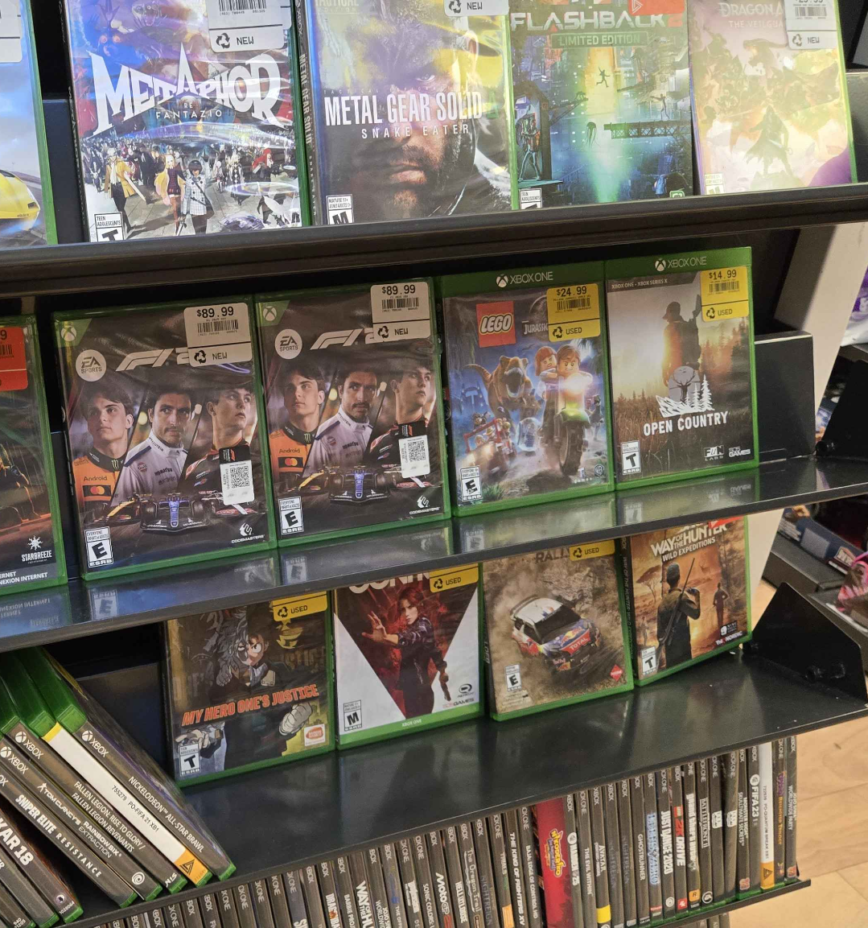
CrossDeals
Team 11 Jeffrey Chou, Nathan Ng, Noah Baldwin
Notes:
Hello, we are Team 11, developers of CrossDeals. I am XX. (switch and introduce in order - speaker of the following slides goes last)

Slide 2
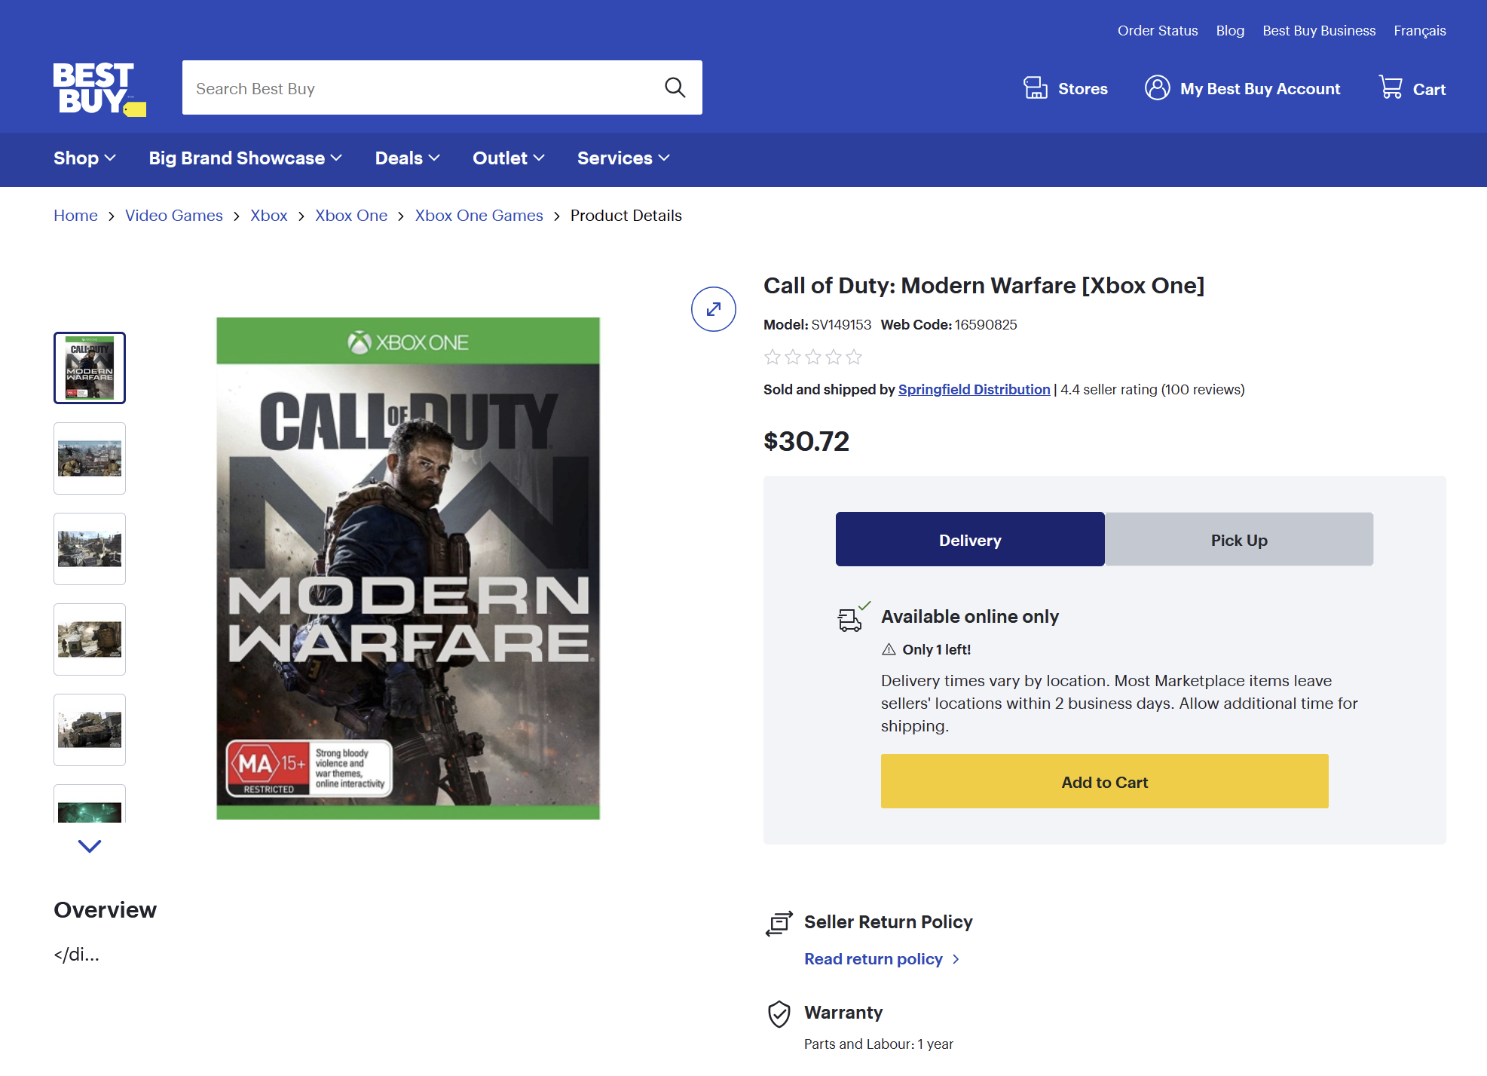
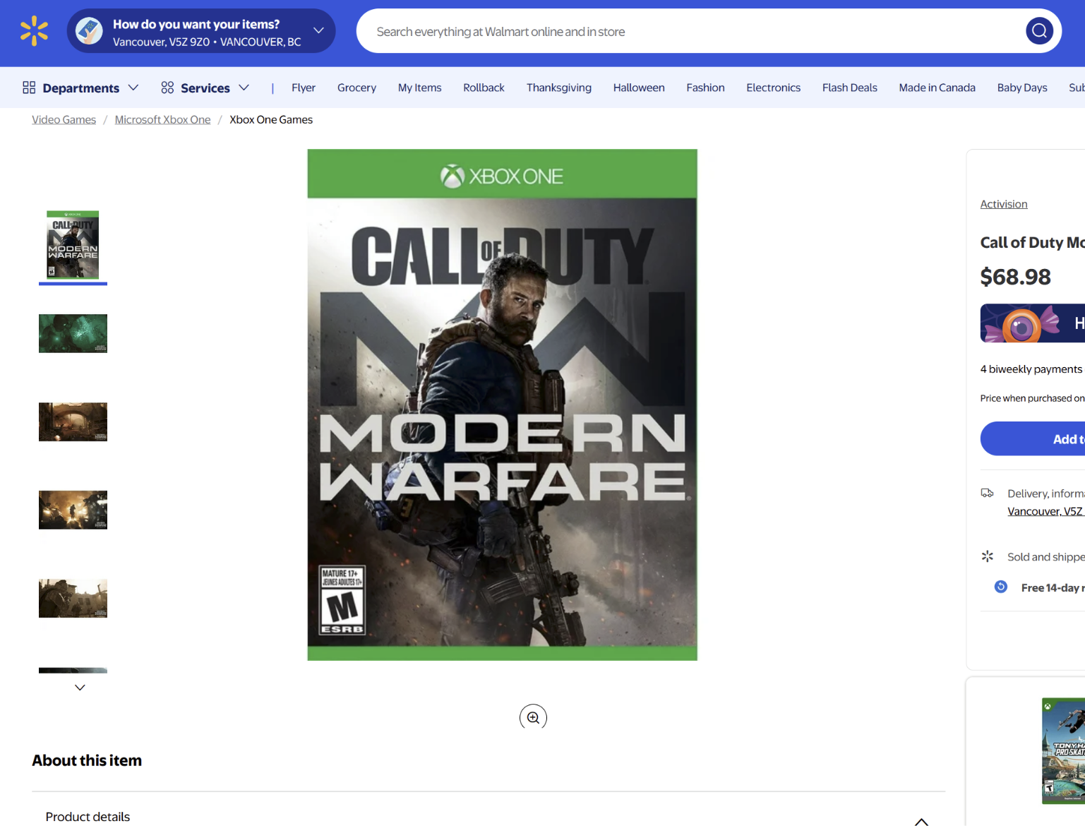
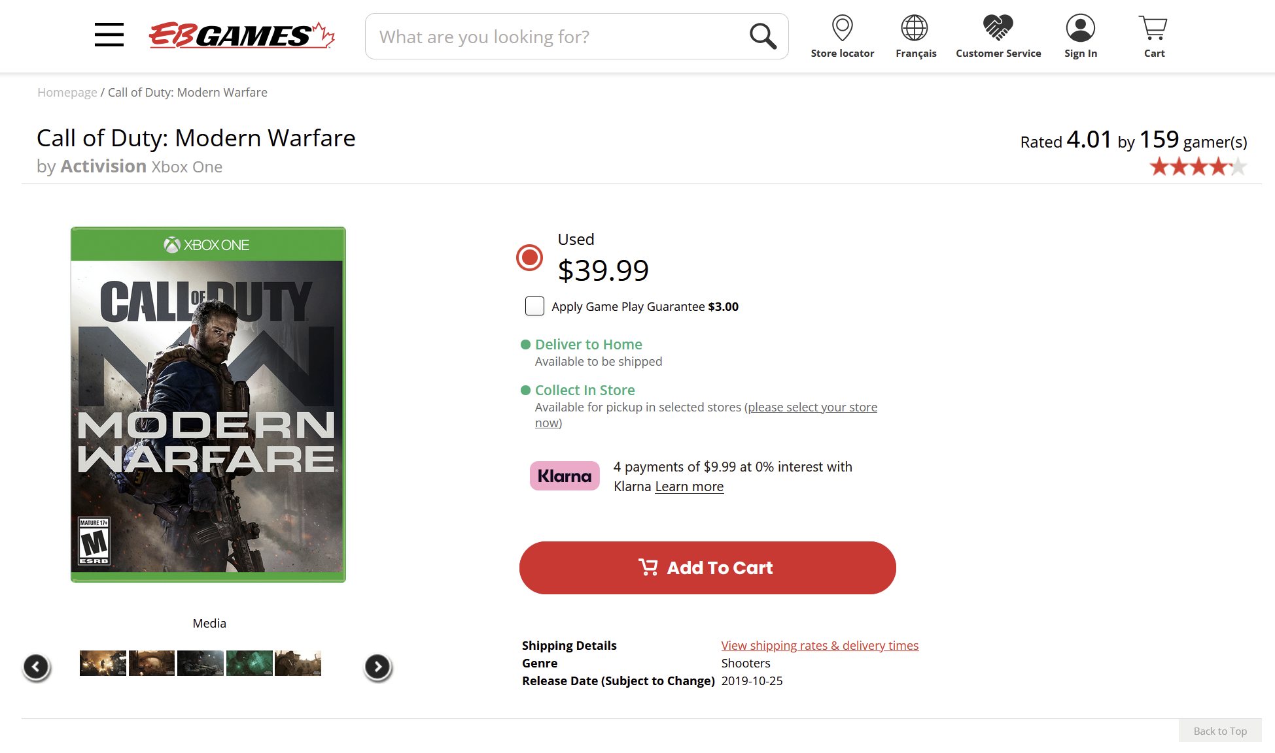
Problem: Cross-platform gamers have no convenient way to compare prices across platforms
Notes:
Just as a reminder, we are making the cross-platform deals aggregator, CrossDeals, and the problem we are trying to solve is cross-platform gamers having to manually compare prices between platforms.

Slide 3

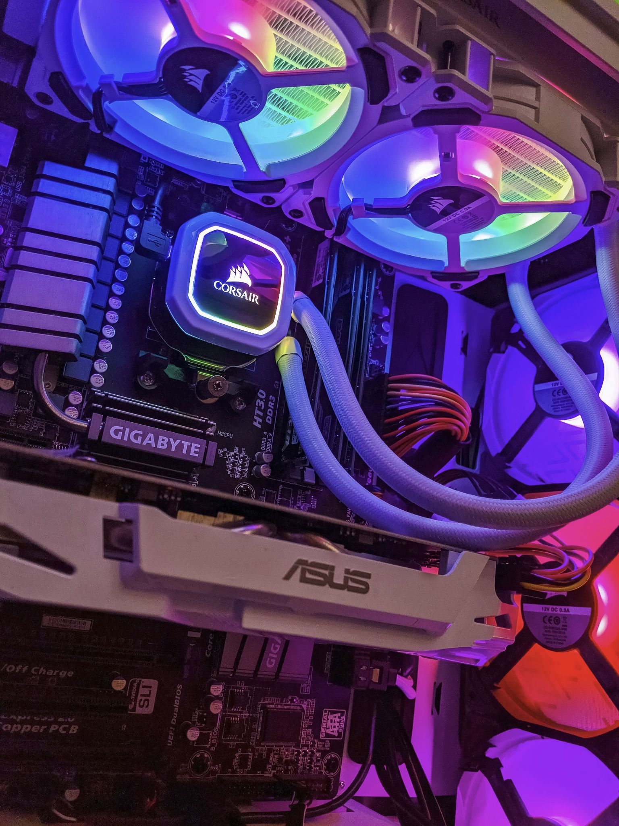
CrossDeals is our solution
Console
Cross-platform
PC
Notes:
Our solution allows gamers to easily compare prices between console stores as well as PC stores.

Slide 4
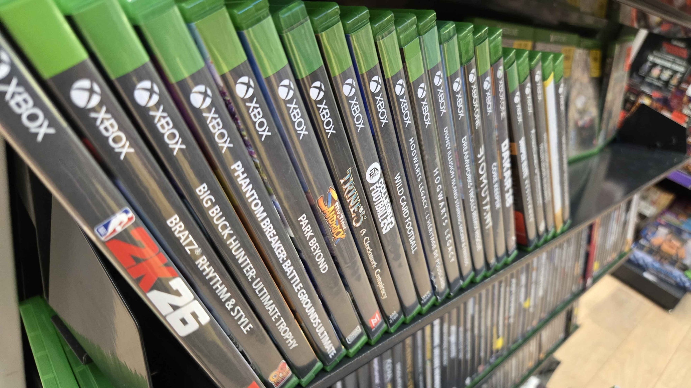

Find deals and pricing information on games
Track game sales and check for sales!
Notes:
Our primary goal is to allow users to track the games they want, and also compare the prices between different platforms.

Slide 5
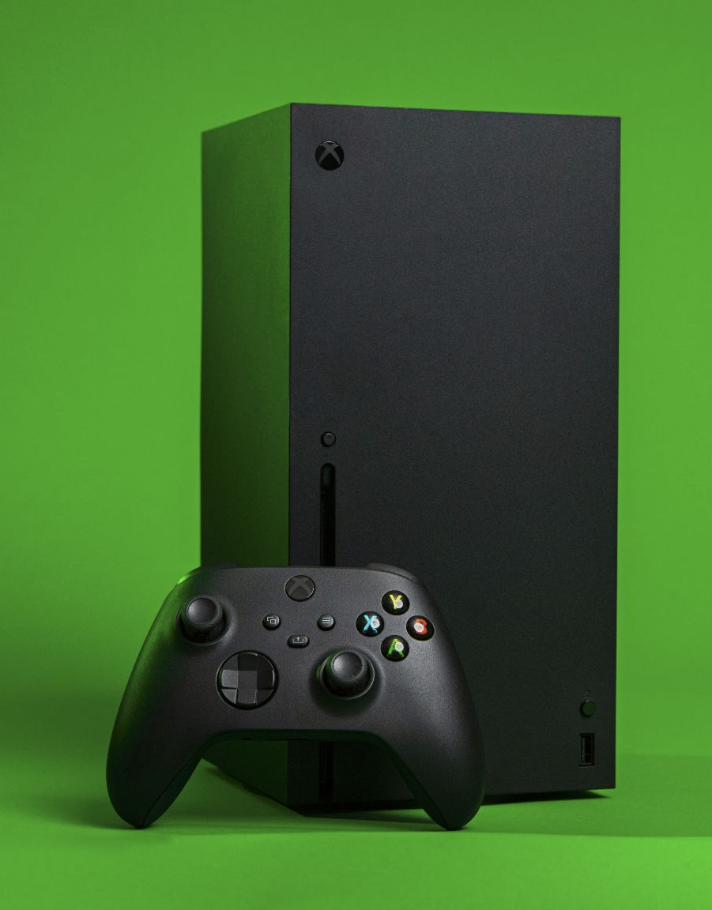
Choose your platforms
We’ll show you deals for all the platforms you own!
Notes:
We are also allowing users to choose their preferred platforms, which will filter out the pricing information on platforms that the user doesn’t own

Slide 6

Track your wishlisted games
Keep track of the games you want, so you know when they go on sale!
Notes:
And of course, we are allowing the user to wishlist games which will always appear on the home screen, allowing the user to grab those deals on their favourite games before it is over!

Slide 7
Project Demo
Notes:
Team lead does the project demo:
Start on the home screen
Create a new user
Redirect back to home screen
Turn off some platforms
Scroll to bottom to show that the Featured Deals only include the platform checked
Mention that the price is also the lowest among our selected platforms
Add some games to wishlist
Go to a game’s details page
Turn on some platforms to show the different pricing cards
Mention the store link for conveniently jumping to each store
Go back home
Show the wishlisted games appearing in “Your Wishlist”
Remove some games
Search for a game
Search for a valid game
Search for an invalid game (type randomly on keyboard)
Logout

Slide 8
Architecture
Notes:
I’ll talk very briefly about the architecture for our project.

Slide 9
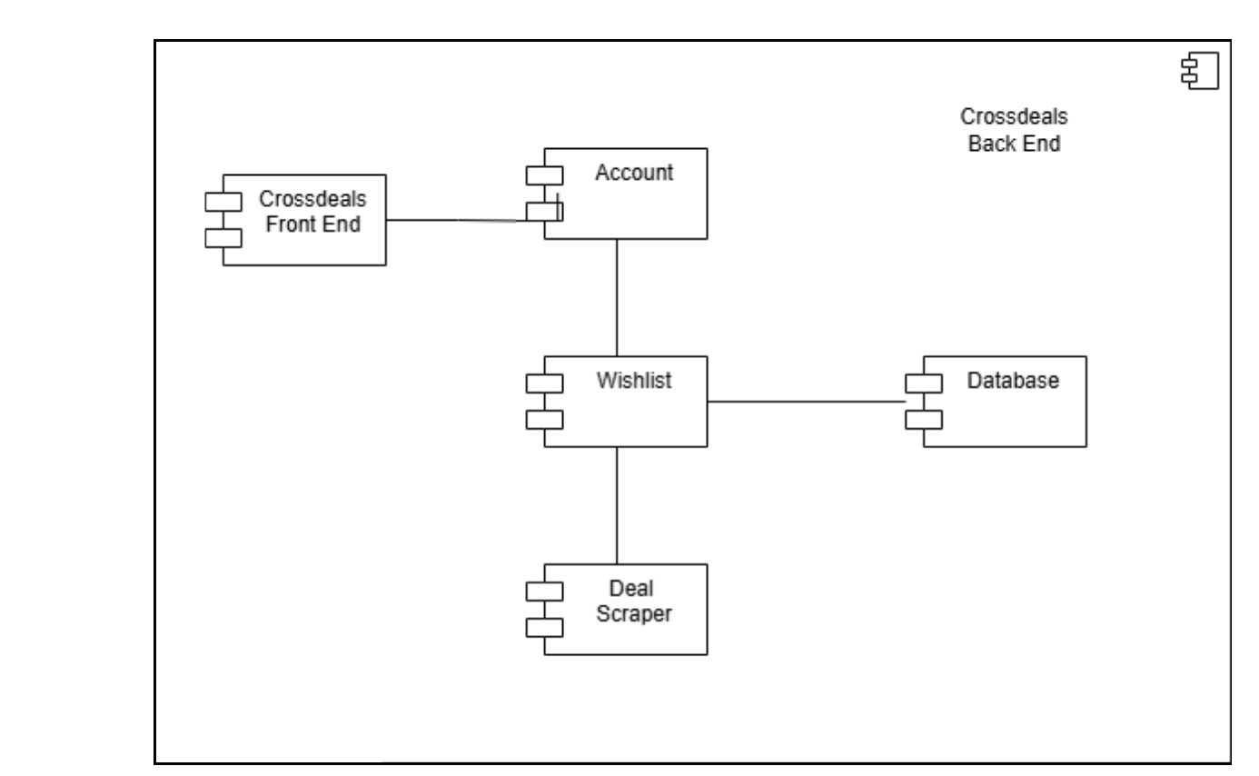
We started with monolithic architecture...
Notes:
In sprint 1 we started off with monolithic architecture, where the backend would render the pages to the frontend.

Slide 10
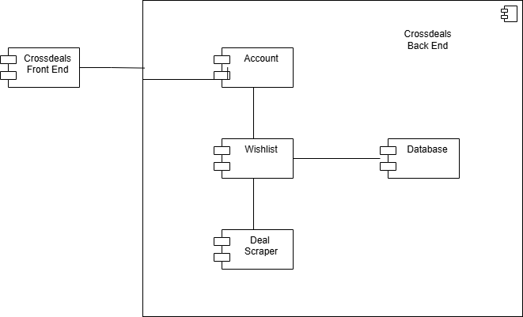
Before changing it to client/server
Notes:
But we ended up switching to the client/server model in sprint 2 because it made teamwork significantly easier, and also meant we could maintain the frontend and backend separately. It also allowed for greater separation of concerns as the backend was entirely responsible for handling logic, while the frontend was concerned about presenting the pages.
We’re using vanilla HTML, CSS, and JavaScript for our frontend, nodeJS and mongo DB for our backend, and Python and Puppeteer for the web scraper.

Slide 11
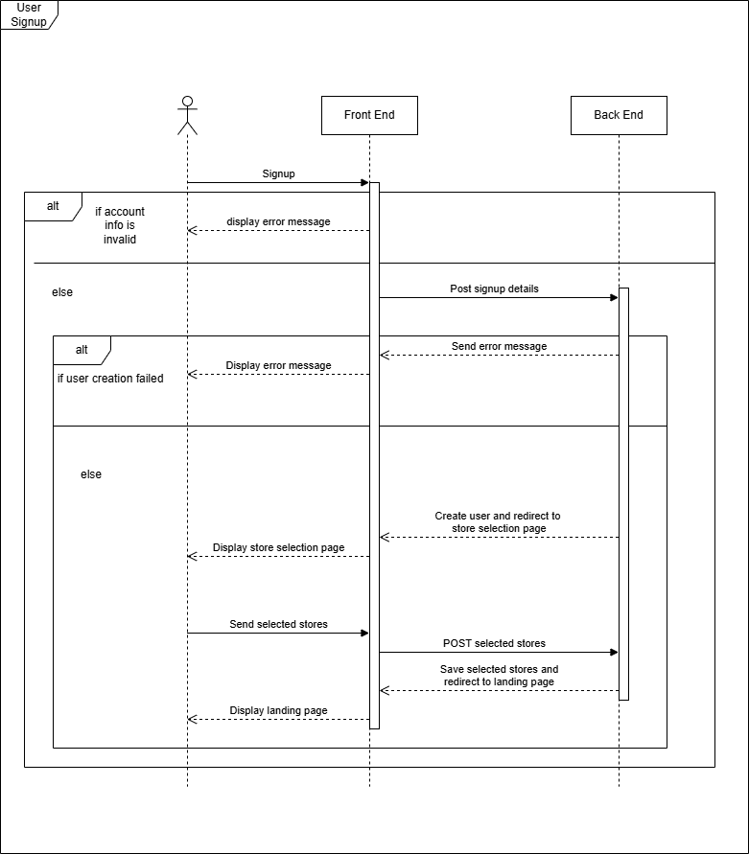
Authentication
Notes:
Here’s the sequence diagram for authentication, it’s about what you’d expect so I’m just going to skip over it.

Slide 12
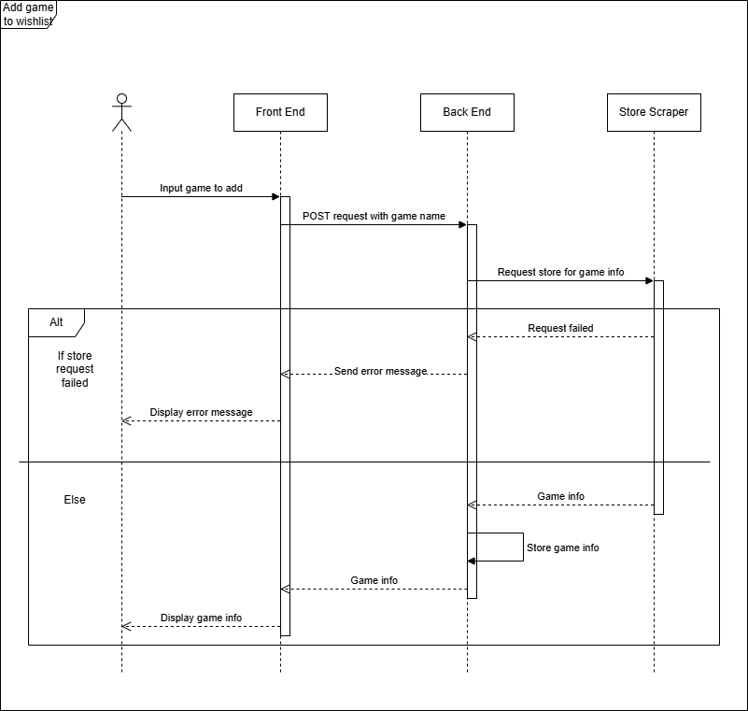
Game Search
Notes:
And here is the sequence diagram for game search. We have a frontend, backend, and the webscraper which scrapes retail websites and adds the information to the backend’s database.

Slide 13
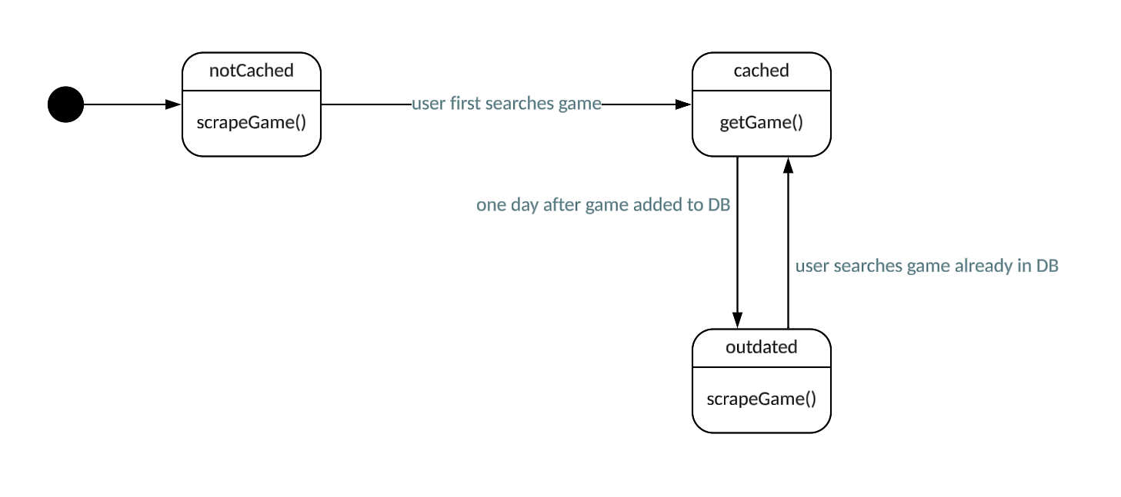
Game Search
Notes:
Basically, how it works is that the first time the user searches for a game, the backend will note that there is no information on the game, so it will use the scraper, add it to the database, and return it to the frontend. If other users try to search for the same game, then the backend can use the same data that is already in the database.

Slide 14
Challenges
We only have three team members
We have less manpower at our disposal
One team member on frontend, one on backend, one on scraper
We needed to scale back our scope and focus on core features
Next time: We should be more realistic with our goals
We were busier than expected with all our courses
We are all in the Game Development option, where we are also working on different games as a term-wide project
Team member availability was a bottleneck when reviewing PRs
We ended up working on this project mostly on Monday and held standups on Mon and Fri
Notes:
We encountered our fair share of challenges with this project. First off, as you might have noticed, we only have three members in our team, meaning we have less manpower. We ended up scaling back some parts of our scope since we were unable to finish everything we originally envisioned. Next time, we will want to be more realistic when estimating our goals.
And we were also quite busy with all our other courses. We are all part of the Game Dev option, where we also have a term-wide project that also uses up a lot of time every week. After realizing our availability was an issue, we ended up dedicating Monday as our team’s main work day, and held standups on Monday and Friday to keep each other in the loop.

Slide 15
Challenges
Miscommunication among team members
It was difficult developing the frontend when the response format was not known
We added API documentation for internal use so that concurrent development between server and client would be smoother
Lesson learned: Slowing down slightly to make documentation at the start will lead to saving lots of time later
Next time: We should agree on the format of data models, APIs, etc before starting implementation
We changed from monolithic architecture to client/server
Many parts of the app, such as authentication and page rendering, were reworked
We think that this approach benefited us in the long run as it allowed for a concurrent workflow between team members
Next time: Agree on architectural and design choices before starting implementation
Notes:
In general, our overall teamwork wasn’t super smooth. We didn’t have documentation starting out this project, so while I was developing the frontend I was also making assumptions about how the backend would respond with data, which sometimes didn’t align with reality. After realizing this was a big issue, we added API documentation and also used the diagrams you saw earlier to facilitate smoother teamwork. We learned from this that oftentimes, it’s better to slow down slightly and come up with a plan and some kind of documentation at the start, since it will end up to saving a lot of time later.
We also started out with monolithic architecture, as XX mentioned, but switched to client/server which was a time-consuming process taking a week for the frontend and backend members. However, we think this approach benefited us in the long run as it allowed us to work on different aspects of a feature, like making the page or handling the logic, at the same time. If we had to do this project again, we probably should have weighed and agreed on architectural design decisions before jumping straight in.

Slide 16
Challenges
The web scraper was developed in a silo
It was not integrated with our backend until very late in the project
We are still working on this functionality
Lesson learned: Merge and test different parts of the project often
Next time: We should work on adding the first scraper to the server before working on more scrapers
Puppeteer was a new and confusing module to use
This was the leading cause for difficulty during development
Led to frustration and misunderstanding on what to do or how to do it
Made completing the requirements of the app difficult to accomplish accurately in the time allotted
Notes:
We’ve also faced some challenges with the web scraper, such as the fact that it wasn’t integrated with the main project until very late. The lesson we’ve learned here was that we should have merged and tested different parts of the project early on in development so it wouldn’t be a problem later.
Additionally, Puppeteer was a new and confusing Python module to use, which was the main reason for why its development tended to trail behind the other parts of the app.

Slide 17
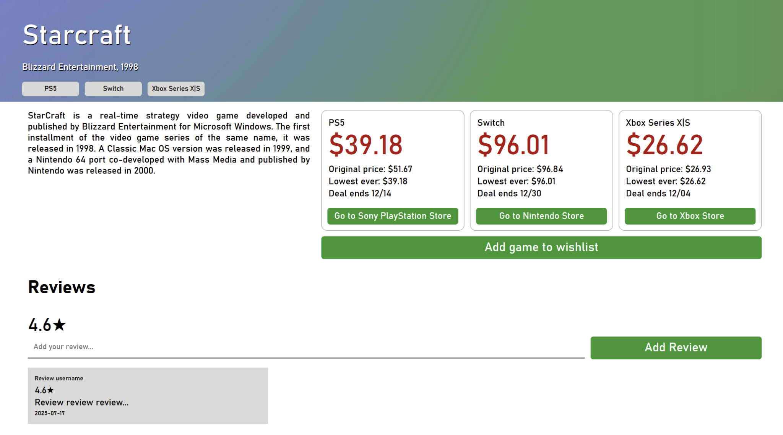
Features Scoped Down / Removed
Cover art and banner art
We did not have time to scrape and add this information to the games database
The frontend uses placeholder images
Pricing over time
We still track best price of all time, but do not show how the price fluctuated
User reviews
We did not end up implementing the review system as it did not align with our problem
Notes:
In the end, we weren’t able to deliver everything we promised, but did complete the core functionality of the app. The things we didn’t complete are the cover and banner art, which are these rainbow images you saw in the demo, because we didn’t have time to scrape and add this information to our database and display the actual art.
We also didn’t have time to track and display pricing over time, but we still track the best price of all time, so at least users can still make an informed decision about whether the sale they are seeing is the best one yet.
Lastly, we wanted to add a review system, but we ended up scrapping this as we realized it didn’t really align with the problem we were trying to solve. Only the frontend had this implemented so we just ended up deleting this part of the page. (But that’s what it would have looked like)

Slide 18
Thank you
Images for this presentation were captured by team members or sourced from Unsplash.

